Slide 1

JNR
JNR Consulting, LLC
Project Manager: Kenneth Robinson
Staff: Megan Summerford
Client: Audrey Moore
URL: http://www.geocities.com/audreymoorenicole

Slide 2
Table of Contents

Slide 3
Table of Contents

Slide 4
Extended Enterprise
JNR Consulting, LLC (Company)
Sell
Research
Produce
Deliver
Service
Ms. Moore (Client)
Research
Sell
Produce
Deliver
Service
Website Visitor
Research
Produce
Sell
Deliver
Service

Slide 5
Extended Enterprise Narrative
JNR Consulting (Company) will Deliver a website to the client, Ms. Moore, with support provided by the Project Manager, Kenneth Robinson.
Ms. Moore (Client) can sell the website to others to better herself.
Website Visitor will be able to visit the website and research information about Ms. Moore. This is essential for potential employers that recruiting for vacant positions.

Slide 6
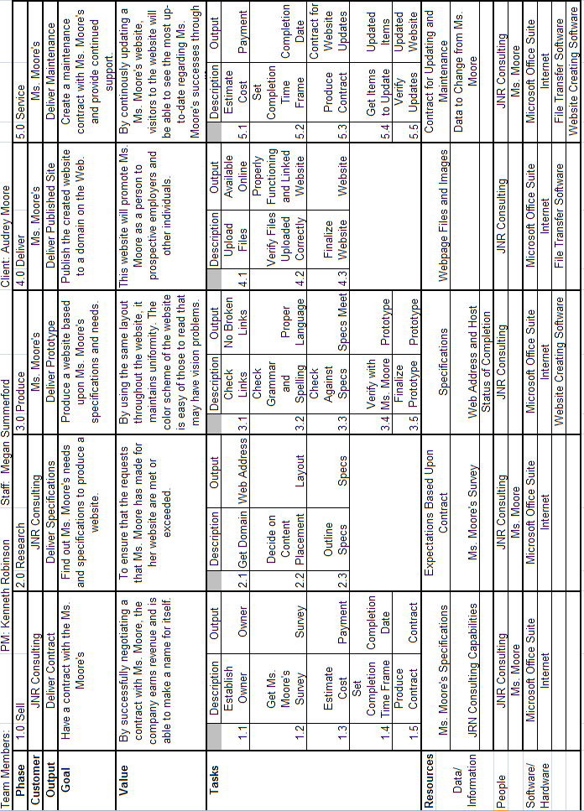
Overall
Table

Slide 7
Overall
WCA
Goal
Customer
Value
To design a website based on Ms. Moore’s criteria
Ms. Moore
Ms. Moore has another method to promote her business on a global level
Product
Ms. Moore’s Website
Work Practices
Sell - set up an agreement between JNR consulting and Ms. Moore
Research- research Ms. Moore’s specifications and need for her website
Produce- a website based on Ms. Moore specifications and needs
Deliver- publish it to a domain
Service- create a maintenance contract with Ms. Moore
Technology
People
Data
Website
Web browsers
Visual webpage editor
Megan Summerford
Kenneth Robinson
Audrey Moore
Ms. Moore
specifications
Ms. Moore’s surveys

Slide 8
Overall WCA Narrative
Goal- to design a website based on Ms. Moore’s criteria
Customer- Ms. Moore
Product – Website
Work Practices
Sell – set up an agreement between JNR consulting and Ms. Moore
Research—research Ms. Moore’s specifications and need for her website
Produce—a website based in specs and needs
Deliver—publish it to a domain
Service—Create a maintenance contract with Ms. Moore
Data—Ms. Moore’s specifications, Ms. Moore’s surveys
People – Ms. Moore, project manager, staff
Technology – web browsers, website, visual webpage editor (FrontPage)
Value— Ms. Moore has another method to promote her business on a global level

Slide 9
Overall Value Chain
Sell
Agreement
Research
Ms. Moore’s specifications
Produce
Website
Value Added
Ms. Moore has another method to promote her business on a global level
Deliver
Published Website
Service
Maintenance contract

Slide 10
Overall VC Narrative
Overall Goal- To design a website based on Ms. Moore’s criteria
Sell – set up an agreement between JNR consulting and Ms. Moore
Research—research Ms. Moore’s specifications and need for her website
Produce—a website based on specs and needs
Deliver—publish it to a domain
Service—Create a maintenance contract with Ms. Moore
Overall Value Added- Ms. Moore has another method to promote her business on a global level

Slide 11
Overall Executive Summary
We recommend that Ms. Moore use JNR Consulting, LLC as their overall website developer. By using JNR Consulting, LLC web development services, the clients webpage will be created in a timely manner. The methodology covers all aspects of the clients needs.
After effectively researching the clients overall needs we have discovered that JNR Consulting, LLC methodology of creating and maintaining the clients website. By creating a specifications and survey application we discover detailed needs for the client, which gives the client total control over the outcome of there webpage. This approach gets the client completely involved with there webpage, which results in an overall excellent outcome.
In this report the methodology of JNR Consulting, LLC used a specific table that help create the phases of the website development process. The table shows the steps taken to process and effective website.
_____________________ ____________________
JNR Project manager Client
____________________ _____________________
Date Date

Slide 12
Table for Sell Phase

Slide 13
Sell WCA
Value
Goal
Customer
By successfully negotiating a contract with Ms. Moore, the company earns revenue and is able to make a better name for itself.
To set up an agreement contract between JNR consulting and Ms. Moore
Ms. Moore
Product
Contract
Work Practices
Research- establish what are Ms. Moore wants and needs for her website and what he hope to get out of having a website
Produce- create a proposal contract, time frame, and budget for Ms. Moore
Sell- the proposals to Ms. Moore
Service- Negotiate the contact with Ms. Moore
Deliver- the final, signed contract to Ms. Moore
Technology
People
Data
Microsoft office
suite
Internet
JNR Consulting
Ms. Moore
Ms. Moore
specifications

Slide 14
Sell WCA Narrative
Goal- To set up an agreement contract between JNR consulting and Ms. Moore
Customer- Project Team
Product- Contract
Work Practices
Research- establish what are Ms. Moore wants and needs for her website and what does he hope to get out of having a website
Produce- create a proposal contract, time frame, and budget for Ms. Moore
Sell- the proposals to Ms. Moore
Service- Negotiate the contact with Ms. Moore
Deliver- the final, signed contract to Ms. Moore
Technology- Microsoft Office Suite, internet
People-JNR Consulting, Ms. Moore
Data- Ms. Moore specifications
Value- By successfully negotiating a contract with Ms. Moore, the company earns revenue and is able to make a better name for itself.

Slide 15
Sell Value Chain
Research
Needs for website
Produce
Proposal contract
Sell
Value Added
Proposal
By successfully negotiating a contract with Ms. Moore, the company earns revenue and is able to make a better name for itself.
Service
Contract
Deliver
Final, signed contract

Slide 16
Sell VC Narrative
Overall Goal:
To set up an agreement contract between JNR consulting and the client
Research- establish what are the clients wants and needs for her website and what do they hope to get out of having a website
Produce- create a proposal contract, time frame, and budget for the client
Sell- the proposals to the client
Service- Negotiate the contact with the client
Deliver- the final, signed contract to the client
Overall Value Added:
By providing our clients with a high quality service it will improve the image of JNR consulting, leading to an increase in business.

Slide 17
Sell Executive Summary
We recommend that Ms. Moore contract with JNR Consulting, LLC because I will ensure the level of the quality of our work is the highest possible. We are committed to meeting the needs of customers for the most reasonable price.
Before finalizing a contract, Ms. Moore will know exactly what will be provided in her website. By using pre-defined work practices, this provides a foundation make sure that all areas of the website are covered.
We recommend moving to the Research Phase and continuing on with the project.
JNR Consulting PM Date
Client Date

Slide 18
Client
Survey
What is the desired time from do this project?
_____________________________________________________
What is your overall goal of your website?
_______________________________________________________
_______________________________________________________
What do you hope to gain with this website?
______________________________________________________________________________________________________________
What are some things you would like to see on your website?
______________________________________________________________________________________________________________
How many pages do you expect your webpage to include?
_____________________________________________________
Who will be browsing/using your website?
_____________________________________________________
What do you want hope your intended viewers will gain from your website?
_______________________________________________________
_______________________________________________________
Additional comments/preferences?
______________________________________________________________________________________________________________

Slide 19
Client Contract
123 Main St. SW
Tuscaloosa, Al 35487
_________________(client) has hired JNR Consulting to construct a website that will be fully operational by _______________(date). For every day late, JNR Consulting will suffer a $200 penalty.__________________(client) agrees to pay JNR Consulting $_________ for the construction of their website. A $_______ deposit will be required upfront to start the project and the remaining portion will be required upon completion. The client has until ______________(date) to cancel the contract, however the deposit will be non-refundable. If canceled later than ______________(cancellation date) the client is legally responsible for the full amount of the project.
JNR Consulting will not be liable for any material given to them by the client, to be put on the website, which infringes any copyright or trademark agreements. When website is complete all web code will be the property of the client, unless they buy a maintenance and service plan, in which case the code will be transferred to the client at the end of the maintenance and service contract.
___________________________________ ____________________________________
JNR Consulting Project Manager Signature Client Signature
_____________________________ ________________________________
Date Date

Slide 20
Table for Research Phase

Slide 21
Research
WCA
Goal
Customer
Value
to Research Ms. Moore specifications and need for her website and relay them to the project team
Ms. Moore
To ensure that the requests that Ms. Moore has made for her website are met or exceeded. This will make things better for her as she looks for a job.
Product
Ms. Moore’s Specifications
Work Practices
Research- Ms. Moore’s goals, expectations, and requirements for her web site
Sell- ideas to Ms. Moore that are in line with her goals and expectations
Service- Revise ideas and goals with what the project team is capable of doing
Produce- the final revised specifications, goals and ideas for the website
Deliver- the final specifications to the project team and web designer
Technology
People
Data
Microsoft Office
Suite
Internet
JNR Consulting
Ms. Moore
Expectations
based upon
contract
Client Survey

Slide 22
Research WCA Narrative
Goal- to research Ms. Moore’s specifications and need for her website and relay them to the project team
Customer- Project team
Product – Ms. Moore specifications for her website
Work Practices
Research- Ms. Moore’s goals, expectations, and requirements for her web site
Sell- ideas to Ms. Moore that are in line with her goals and expectations
Service- Revise ideas and goals with what the project team is capable of doing
Produce- the final revised specifications, goals and ideas for the website
Deliver- the final specifications to the project team and web designer
Technology- Microsoft Office Suite, internet
People-JNR Consulting, Ms. Moore
Data- Expectations based upon contract, Client Survey
Value-To ensure that the requests that Ms. Moore has made for her website are met or exceeded. This will make things better for her as she looks for a job.

Slide 23
Research Value Chain
Research
Ms. Moore’s goals, expectations, and requirements
Sell
Ideas
Service
Revise ideas
Value added
To lay ground work for JNR consulting to produce a website specified by Ms. Moore’s request
Produce
Final revised specifications
Deliver
The final specifications to the project team

Slide 24
Research VC Narrative
Overall Goal:
To research Ms Moore’s specifications and need for her website and relay them to the project team
Research- Ms. Moore’s goals, expectations, and requirements for her web site
Sell- Ideas to Ms. Moore that are in line with her goals and expectations
Service- Revise ideas and goals with what the project team is capable of doing
Produce- the final revised specifications, goals and ideas for the website
Deliver- the final specifications to the project team and web designer
Overall Value Added:
To lay ground work for JNR consulting to produce a website specified by Ms. Moore's request

Slide 25
Research Executive Summary
We recommend that the website production proceed on to the Produce phase, continuing the process of creating and publishing the client’s website. . The methodology developed by JNR Consulting to execute the Delivery phase covers every aspect of the Produce phase process in a quick, efficient and effective manner.
Using this methodology, JNR Consulting is able to establish website specifications for the project. A discussion of the clients desires determine the client’s expectations. These expectations are modified to reflect what would be possible for the project team to accomplish with the resources they are given. These modifications are discussed with the client to ensure compliance with the client’s desires.
The methodology used by JNR Consulting to execute the Research phase creates website specifications using a variety of methods outlined in the table for Research phase. The table outlines the steps such as defining goals and the value of these goals, the people, data, and technology it takes to make these goals happen, and the product and customer we will be working with. A value chain defines the value added by each step of our practices. JNR consulting personnel has concluded that this methodology is satisfactory at meeting and exceeding project goals.
_____________________ _______________________
JNR Project Manager Client
_______________________________ ____________________________________
Date Date

Slide 26
Website Specifications
Buyers Comments:_________________________________________________________
Buyers Comments:_________________________________________________________
Buyers Comments:_________________________________________________________
Or Create your own layout

Slide 27
Website Specifications
Font: Georgia Times New Roman Arial Black
Number of Pages desired:___________
Background Color: Insert a least three color codes on the lines below ( See Chart on following page)
_________________ ________________ ________________
Web site Specifications List :
Buyer’s Comments:
_______________________________________________________________________________________________________________________________________________________________________________________________________________

Slide 28
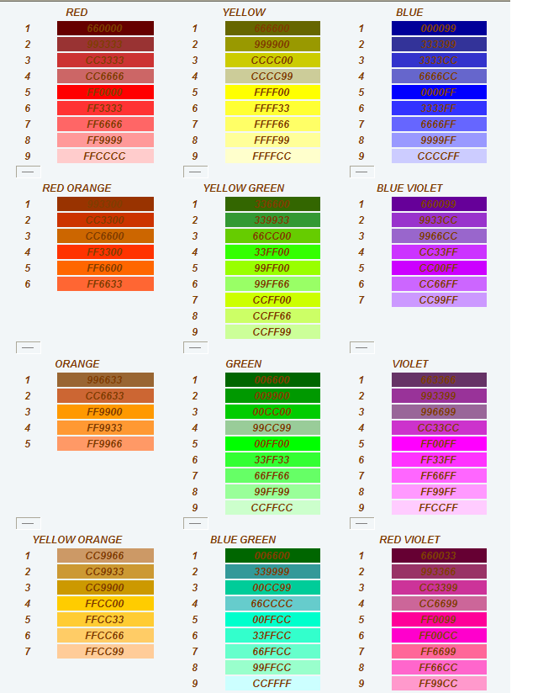
Website Specifications

Slide 29
Table for Produce Phase

Slide 30
Sub-Table for Produce Phase

Slide 31
Produce
WCA
Goal
Customer
Value
Produce a website based on the Ms. Moore’s specifications
Ms. Moore
By using the same layout throughout the website, it maintains uniformity. This will benefit Ms. Moore because hiring companies will be able to find out information about Ms. Moore faster.
Product
Website template
Work Practices
Research- What is the most appropriate web development software application to use for the Ms. Moore's website
Produce- a template of the website based on all the research
Sell- the template to Ms. Moore for approval
Service- the template based on Ms. Moore’s feedback, likes and dislikes about the model
Deliver- the final template website to Ms. Moore for acceptance
Technology
People
Data
Microsoft Office
Suite
Internet
Web creating
software
Specifications
web address
and host
Status
completion
JNR Consulting
Ms. Moore

Slide 32
Produce WCA Narrative
Goal- Produce a website based on Ms. Moore's specifications and needs
Customer- Ms. Moore
Product- Website Template
Work Practices-
Research- What is the most appropriate web development software application to use for Ms. Moore's website
Produce- a template of the website based on all the research
Sell- the template website to Ms. Moore for approval
Service- the template based on Ms. Moore's feedback, likes and dislikes about the model
Deliver- the final website to Ms. Moore for acceptance
Technology- Microsoft Office Suite, internet, Web creating software
People-JNR Consulting
Data- Specifications, web address and host, status completion
Value- By using the same layout throughout the website, it maintains uniformity. This will benefit Ms. Moore because hiring companies will be able to find out information about Ms. Moore faster.

Slide 33
Produce Value Chain
Research
Appropriate web development software
Produce
Template of website
Value Added
Sell
By using the same layout throughout the website, it maintains uniformity. This will benefit Ms. Moore because hiring companies will be able to find out information about Ms. Moore faster.
Contract
Service
Revised
Template based on Ms. Moore feedback
Deliver
Final website to Ms. Moore

Slide 34
Produce VC Narrative
Overall Goal: Produce a website based on Ms. Moore's specifications
Research- What is the most appropriate web development software application to use for Ms. Moore's website
Produce- a template of the website based on all the research
Sell- the template website to Ms. Moore for approval
Service- the template based on Ms. Moore's feedback, likes and dislikes about the model
Deliver- the final website to Ms. Moore for acceptance
Overall Value: By creating a template it makes the website easier to navigate and find information the visitor was looking for

Slide 35
Produce Executive Summary
We recommend that the website production proceed on to the Deliver phase, continuing the process creating and publishing the client’s website. The methodology developed by JNR Consulting to execute the Delivery phase covers every aspect of the delivery phase process in a quick, efficient and effective manner.
Using this methodology, JNR Consulting is able to create a website prototype that contains the specifications produced by the Research phase. A basic site design was constructed based on these specifications. This prototype was viewed and revised by the client to reflect improvements by the client and the JNR Consulting project team. These revisions were included to deliver a final website prototype, and prototype was confirmed to ensure compliance with original website specifications.
The methodology used by JNR Consulting to execute the Produce phase creates a prototype website using a variety of methods outlined in the table for Produce phase. The table outlines the steps such as defining goals and the value of these goals, the people, data, and technology it takes to make these goals happen, and the product and customer we will be working with. A value chain defines the value added by each step of our practices. JNR consulting personnel has concluded that this methodology is satisfactory at meeting and exceeding project goals.
_____________________ _______________________
JNR Project Manager Client
____________________________ ______________________________
Date Date

Slide 36
Navigation Map
Index.html
about.html
photos.html
resume.doc
Email
Notes:
Goes under Produce

Slide 37
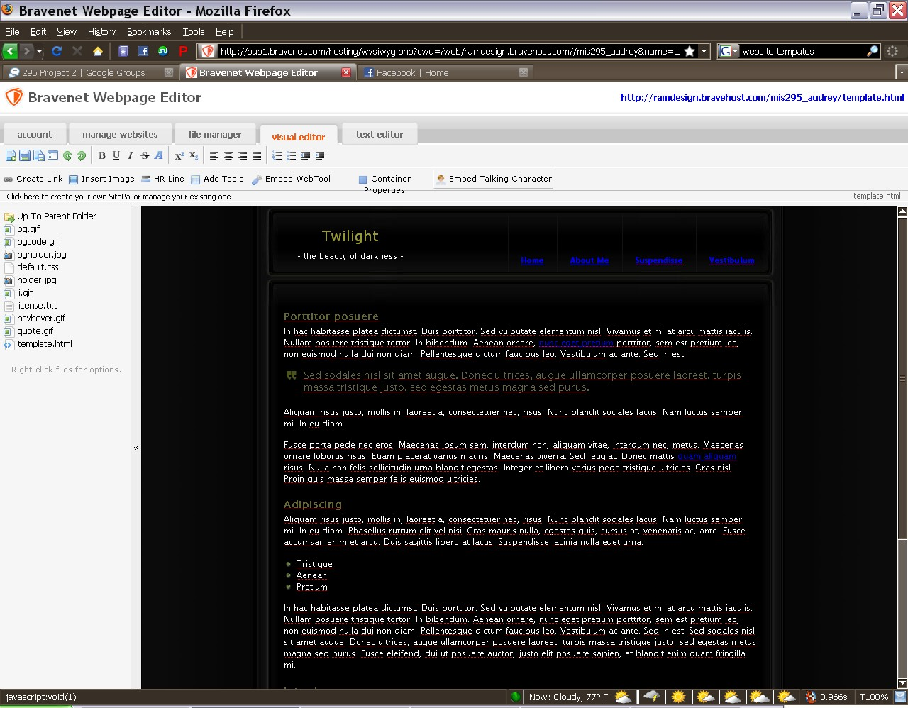
Website Template
Website Template on Webpage Editor
Notes:
Goes under Produce

Slide 38
Table for Deliver Phase

Slide 39
Deliver
WCA
Goal
Customer
Value
Publish the created website to a domain on the web
Ms. Moore
The website promotes the companies services and/or products to any one with computer access
Product
Published Website
Work Practices
Research- the cost and benefit of each domain, which is better for Ms. Moore, and how to publish to that domain
Sell- your domain research to Ms. Moore
Produce- with the input of the client and our research choose the best fitting domain for Ms. Moore's website
Service- make corrections to coding to load chosen domain
Deliver- the published website
Technology
People
Data
Microsoft Office
Suite
Internet
File transfer
software
JNR Consulting
Webpage files
and Images

Slide 40
Deliver WCA Narrative
Goal- Publish the created website to a domain on the web
Customer- Ms. Moore
Product-Published Website
Work Practices-
Research- the cost and benefit of each domain, which is better for Ms. Moore, and how to publish to that domain
Sell- your domain research to Ms. Moore
Produce- with the input of Ms. Moore and our research choose the best fitting domain for Ms. Moore's website
Service- make corrections to coding to load to chosen domain
Deliver- the published website
Technology- Microsoft Office Suite, Internet, File transfer software
People-JNR Consulting
Data- Webpage files and Images
Value-the website promotes the companies services and/or products to any one with computer access

Slide 41
Deliver
Value Chain
Research
Domain Research
Sell
Contract
Produce
Best fitting domain
Value Added
The website promotes the companies services and/or products to any one with computer access
Service
Corrections to coding
Deliver
Published website

Slide 42
Deliver VC Narrative
Overall Goal - Publish the created website to a domain on the web
Research- the cost and benefit of each domain, which is better for Ms. Moore, and how to publish to that domain
Sell- your domain research to Ms. Moore
Produce- with the input of the client and our research choose the best fitting domain for Ms. Moore’s website
Service- make corrections to coding to load to chosen domain
Deliver- the published website
Overall Value Added - The website promotes the companies services and/or products to any one with computer access

Slide 43
Deliver Executive Summary
We recommend that the website production proceed on to the service phase, continuing the process of creating and publishing the client’s website. The methodology developed by JNR Consulting to execute the Delivery phase covers every aspect of the delivery phase process in a quick, efficient and effective manner.
Using this methodology, JNR Consulting was able to insert the completed website into the internet and make it accessible to anyone with an internet connection. Research of the domain hosting solutions brings in the correct domain solution to be used by the website. The information is presented to the client for approval. Based on the choice of domain, the website is then formatted to comply with the specifications of the chosen domain, and this finalized website is published and validated to ensure compliance with the domain requirements and client’s desires.
The methodology used by JNR Consulting to execute the Delivery phase creates a completed website fully hosted on the website using a variety of methods outlines in the table and WCA for the delivery phase. The table outlines the steps such as defining goals and the value of these goals, the people, data, and technology it takes to make these goals happen, and the product and customer we will be working with. A value chain defines the value added by each step of our practices. JNR consulting personnel has concluded that this methodology is satisfactory at meeting and exceeding project goals.
_____________________ ______________________
JNR Project Manager Client
____________________________ ______________________________
Date Date

Slide 44
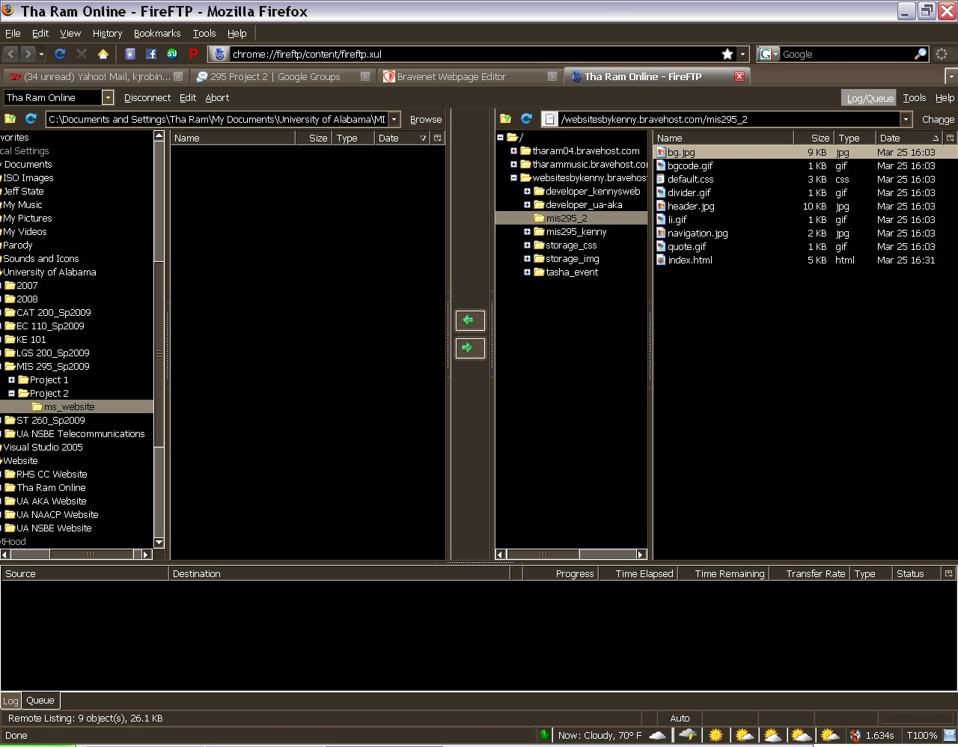
File Upload Screenshot
Screenshot of files being uploaded via FTP (File Transfer Protocol)

Slide 45
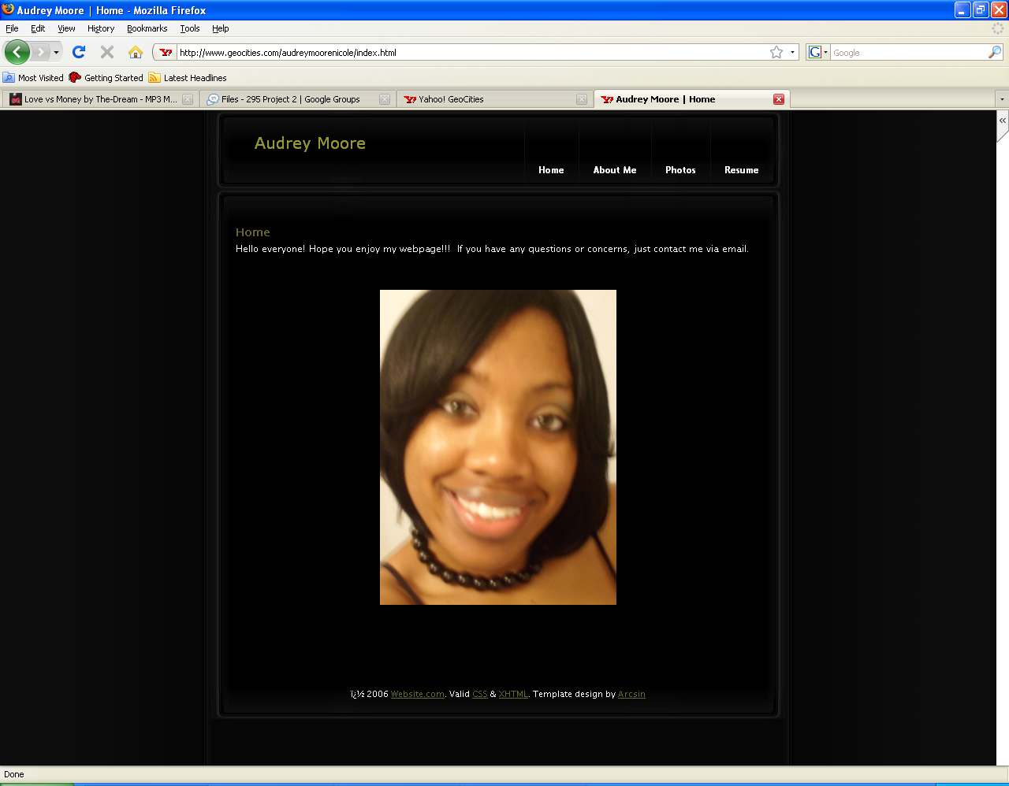
Website Screenshot
Website Homepage

Slide 46
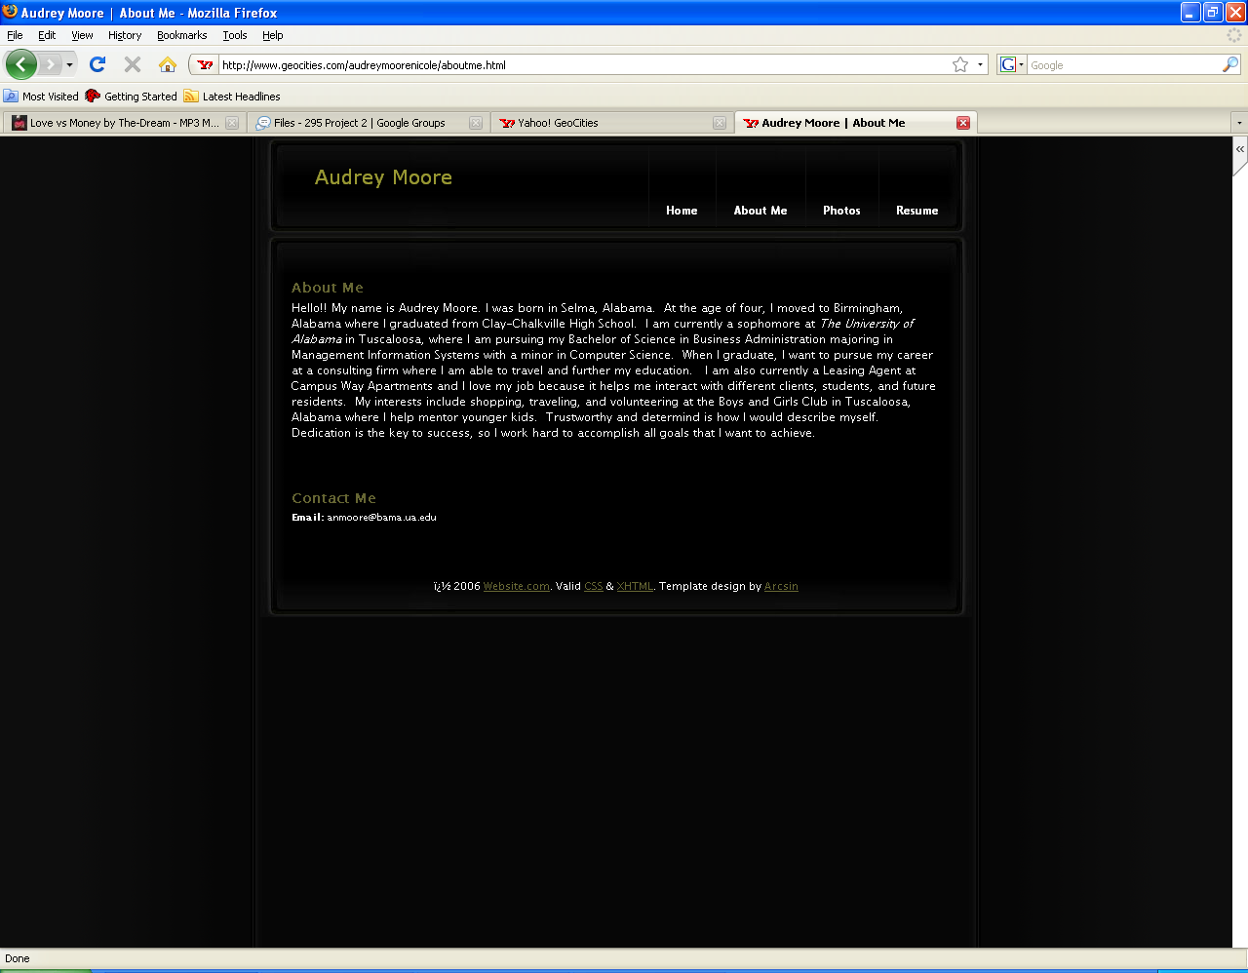
Website Screenshot
“About Me” page

Slide 47
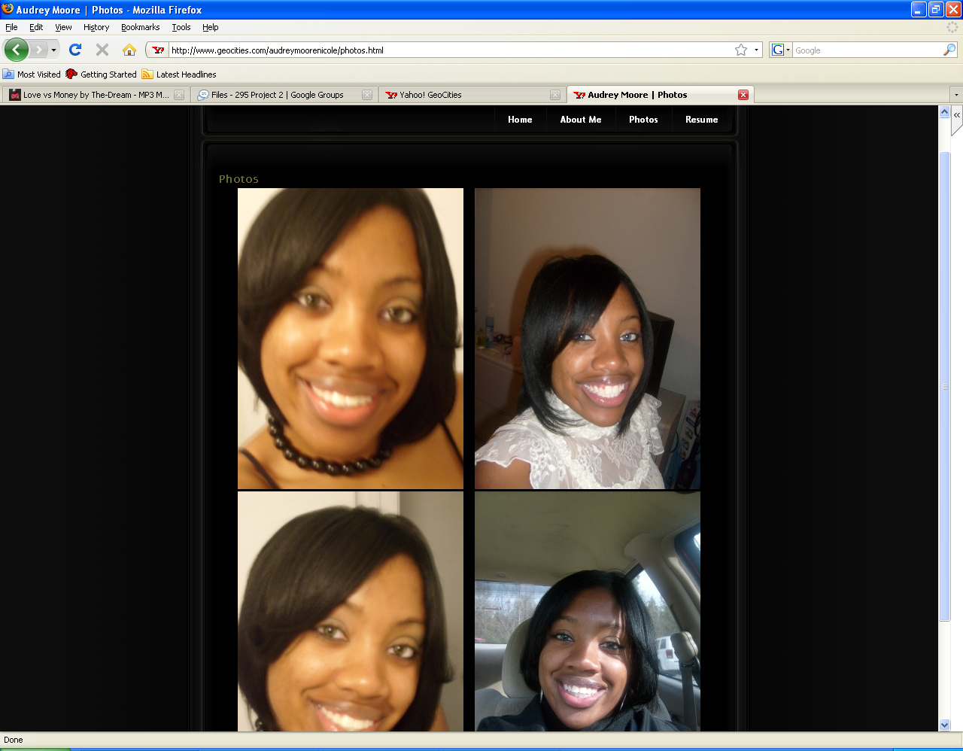
Website Screenshot
“Photos” page

Slide 48
Table for Service Phase

Slide 49
Service
WCA
Goal
Value
Customer
To create a maintenance and service contract with Ms. Moore and provide continued support
Ms. Moore
By continuously updating Ms. Moore's website, it will be cheaper instead of letting it become outdate and having it completely redone.
Product
Maintenance and service contract
Work Practices
Research- the normal cost of maintenance and service for a website
Produce- based on the research findings create a maintenance and service contract
Sell- the maintenance and service contract to Ms. Moore
Deliver-receive a signed copy of the maintenance and service contract
Service- follow up on all maintenance and services needed
Technology
People
Data
Microsoft Office
Suite
Internet
File transfer software
Web creating
software
JNR Consulting
Ms. Moore
Data to change
from client
Contact for update
and maintenance

Slide 50
Service WCA Narrative
Goal-To create a maintenance and service contract with Ms. Moore and provide continued support
Customer- Ms. Moore
Product- Maintenance and service contract
Work Practices-
Research- the normal cost of maintenance and service for a website
Produce- based on the research findings create a maintenance and service contract
Sell- the maintenance and service contract to Ms. Moore
Deliver- receive a signed copy of the maintenance and service contract
Service- follow up on all maintenance and services needed
Technology- Microsoft Office Suite, Internet, File transfer software, Web creating software
People-JNR Consulting, Ms Moore
Data- Contact for update and maintenance, Data to change from Ms. Moore
Value-By continuously updating Ms. Moore's website, it will be cheaper instead of letting it become outdate and having it completely redone.

Slide 51
Service
Value Chain
Research
Maintenance Cost and Services
Produce
Maintenance and service contract
Sell
Value Added
Signed
Contract
By continuously updating Ms. Moore's website, it will be cheaper instead of letting it become outdate and having it completely redone.
Deliver
Receive signed
contract
Service
Follow up on needs

Slide 52
Service VC Narrative
Overall Goal-
To create a maintenance and service contract with Ms. Moore and provide continued support
Research- the normal cost of maintenance and service for a website
Produce- based on the research findings create a maintenance and service contract
Sell- the maintenance and service contract to Ms. Moore
Deliver-receive a signed copy of the maintenance and service contract
Service- follow up on all maintenance and services needed
Overall Value Added-
By continuously updating Ms. Moore’s website visitors to the website will be able to see the most up-to-date regarding Ms. Moore’s business

Slide 53
Service Executive Summary
We recommend that the website construction project be considered complete. The methodology developed by JNR Consulting to execute the Service phase covers every aspect of the Service phase process in a quick, efficient and effective manner.
Using this methodology, JNR Consulting is able to establish the foundation of a service contract. Through much research we are able to determine the expected cost of providing maintenance for the client’s website. The information found in our research is used to construct our Service and Maintenance contract. This contract is verified and signed by the client as well as the project manager.
The methodology used by JNR Consulting to perform the Service Phase creates a service contract using a variety of methods outlined in the table and the WCA for the Service phase. The table outlines the steps such as defining goals and the value of these goals, the people, data, and technology it takes to make these goals happen, and the product and customer we will be working with. A value chain defines the value added by each step of our practices. JNR consulting personnel has concluded that this methodology is satisfactory at meeting and exceeding project goals.
______________________ _____________________
JNR Project Manager Client
_______________________________ ______________________________
Date Date

Slide 54
Service and Maintenance Contract
The terms of the contract are as follows:
The client has these options to a service and maintenance contract:
1 Year Service and Maintenance Contract $250
2 Year Service and Maintenance Contract $450
10 Year Service and Maintenance Contract $1,500
Lifetime Service and Maintenance Contract $3,000
No Service Contract
As the client I understand that if I choose not to sign a service and maintenance contract JNR Consulting is not held liable for any damages, changes, viruses, ect. on the website. I understand that the code to the website will be given to me at the completion of the project and I am responsible for any fees the website may incur.
All service contracts include minor changes to the website, 24 hour phone and e-mail technical support, cost associated with hosting the site, and weekly check-ups to the site to be sure everything is functioning properly.
Minor changes include but are not limited to changes to site graphic, text, and links. In the event of any major changes that you wish to make to the website, such as changes to site structure and major redesign of the site, there will be a fee that will be decided upon by the staff of JNR Consulting.
JNR Consulting reserves the right to make the final decision on what constitutes as a major or minor change to the site.
I have read the entire Service and Maintenance Contract and I understand and agree to the terms and conditions that are set forth in this contract:
_________________________ ___________________________
JNR Project Manager Client
__________________________ ______________________________
Date Date

Slide 55
Repository

